Slide 1
How To Check Your Grades
Where are instructor comments?

Slide 4
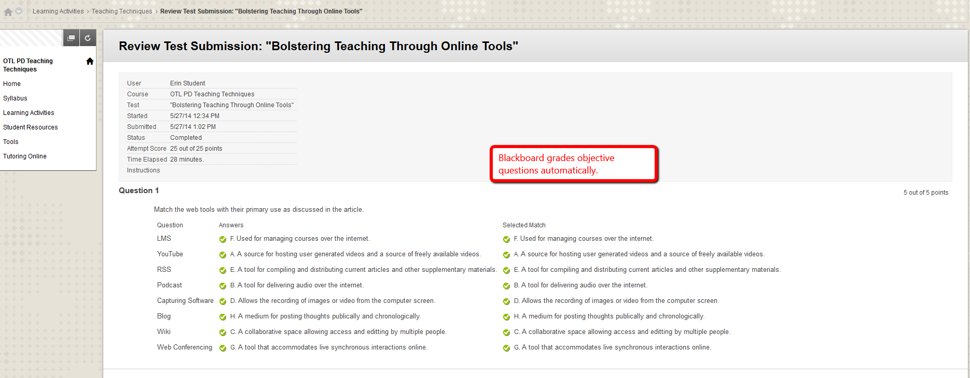

Slide 5
